Slide 1
Stacks

Slide 2
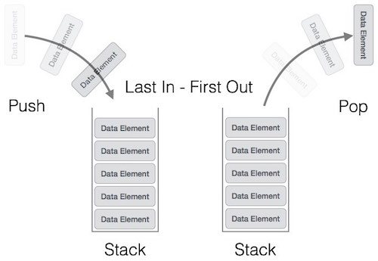
Stacks
Stack is a linear data structure which follows a particular order in which the operations are performed.
The order may be LIFO(Last In First Out) or FILO(First In Last Out).

Slide 3
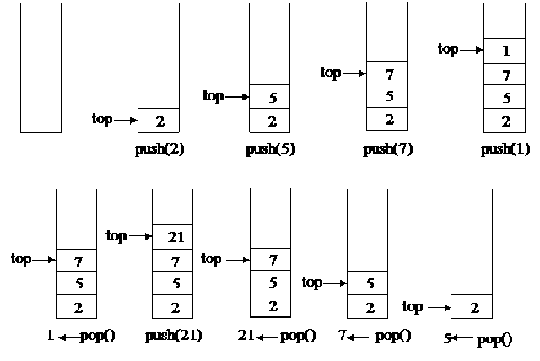
Operation on Stacks
Push operation-The insertion of an element into stack
Pop operation - Deletion of an element from the stack
In stack we always keep track of the last element present in the list with a pointer called top.

Slide 4
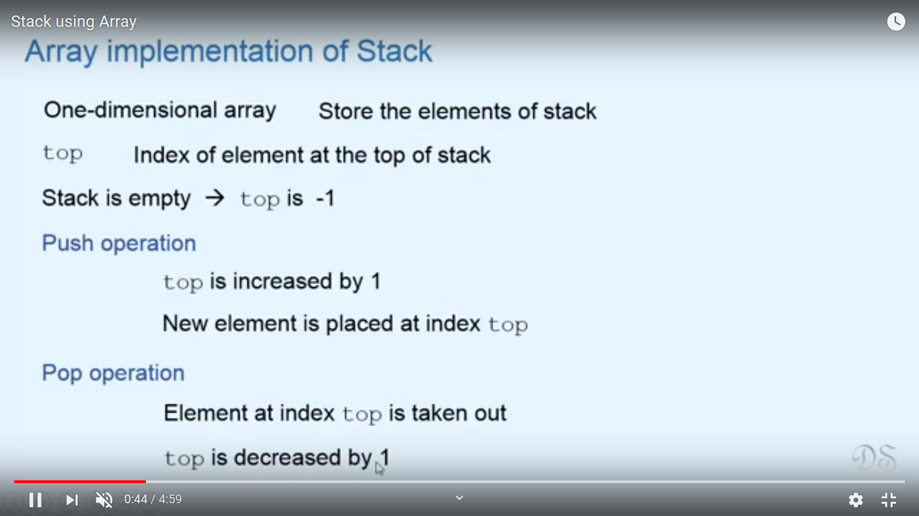
Array Implementation of Stack

Slide 5
Array Implementation of Stack

Slide 6
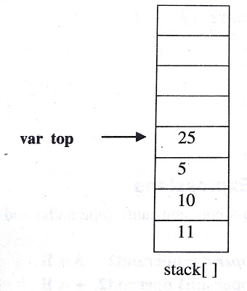
Array Implementation of Stack
Push element one by one onto stack from 0th position to n-1 th position.
Variable top=position of the top element in the array
If there is no element in the stack, value of top will be -1

Slide 7
Stack Overflow /FullCondition
  If(top==MAX-1)
  Then print stack is full or overflowing

Slide 8
Stack Underflow /Empty Condition
  If(top== -1)
  Then print stack is empty or underflowing

Slide 9
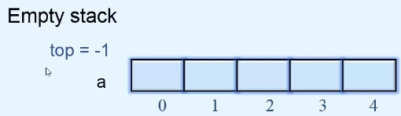
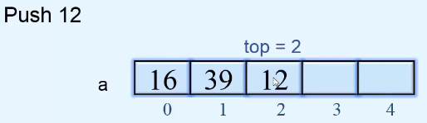
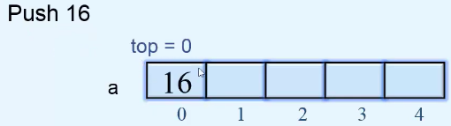
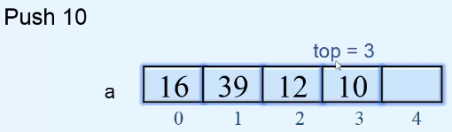
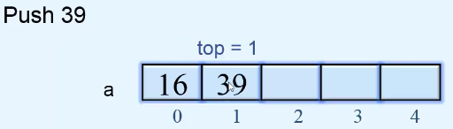
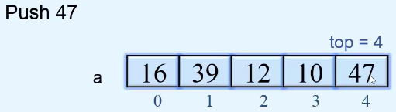
PUSH Operation on Stack

Slide 10
Algorithm for PUSH Operation
Check Stack Full condition
  If(top==MAX-1)
  Then print stack is full or overflow
Otherwise increase the top value by 1
  top=top+1
Input the value
Assign the item at top position stack_arr[top]=pushed_item

Slide 11
Try writing the code for Push Operation function

Slide 12
PUSH Operation
push()
{
int pushed_item;
if(top == (MAX-1))
printf("Stack Overflow\n");
else
{
printf("Enter the item to be pushed in stack : ");
scanf("%d",&pushed_item);
top=top+1;
stack_arr[top] = pushed_item;
}
}/*End of push()*/

Slide 13
POP Operation on Stack
Stack Underflow condition
  If(top== -1)

Slide 14
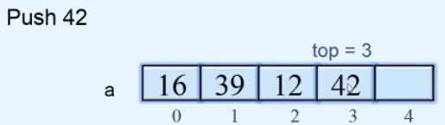
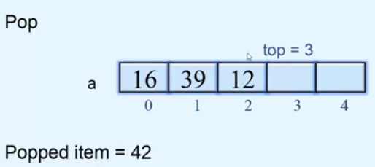
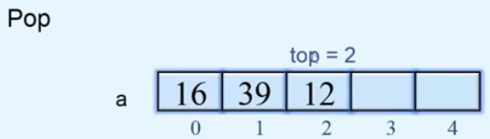
POP Operation on Stack
Popping the elements

Slide 15
Algorithm for POP Operation
Check Stack Underflow condition
  If(top== -1)
  Then print stack is underflow
Otherwise, delete the top position element
  Popped_item=stack_arr[top]
Decrease the position of top
  top=top-1
Print the popped_item

Slide 16
Try writing the code for Pop Operation function

Slide 17
POP Operation
pop()
{
if(top == -1)
printf("Stack Underflow\n");
else
{
printf("Popped element is : %d\n",stack_arr[top]);
top=top-1;
}
}/*End of pop()*/

Slide 18
Try writing the code for Display Operation function

Slide 19
Display fn
display()
{
int i;
if(top == -1)
printf("Stack is empty\n");
else
{
printf("Stack elements :\n");
for(i = top; i >=0; i--)
printf("%d\n", stack_arr[i] );
}
}/*End of display()*/

Slide 20
Peek Operation
An operation on certain abstract data types, specifically sequential collections such as stacks and queues,
  which returns the value of the top ("front") of the collection
  without removing the element from the collection.
  It thus returns the same value as operations such as "pop" or "dequeue", but does not modify the data.

Slide 21
Peek Operation
The name "peek"
  the name for this operation varies depending on data type and language.
Peek is generally considered an inessential operation,
  not included in the basic definition of these data types.

Slide 22
Peek Operation
Sequential types for which peek is often implemented include:
  Stack
  Queue
  Priority queue (such as a heap)
  Double-ended queue (deque)
  Double-ended priority queue (DEPQ)

Slide 23
Peek Operation
Single-ended types, such as stack,
  generally only admit a single peek, at the end that is modified.
Double-ended types, such as deques,
  admit two peeks, one at each end.
Names for peek vary.
  For queues "front" is common.
  Dequeues have varied names, often "front" and "back" or "first" and "last".
  The name "peak" is also occasionally found

Slide 24
Linked List Representationof Stack

Slide 25
Linked List Representation of Stack
The info field of the node holds the elements of the stack
Link fields hold pointers to the neighbouring element in the stack
The start pointer behaves as the TOP pointer variable of the stack
Null pointer of the last node in the linked list signals the bottom of the stack

Slide 26
Linked List Representation of Stack
struct node
{
int info;
struct node *link;
} *top=NULL;

Slide 27
Push Operation
Inserting a node into the front or start of the list. i.e. at the top of the stack
Stack after Before Push Operation,
Stack after Push Operation, Push www into stack, inserted at Top
Bottom of Stack
Top
XXX
YYY
ZZZ | NULL
Bottom of Stack
Top
WWW
XXX
YYY
ZZZ | NULL

Slide 28
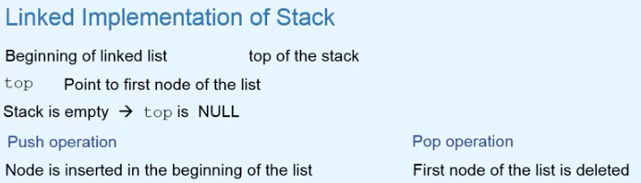
Linked List Representation of Stack

Slide 29
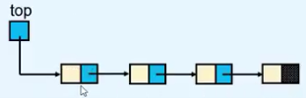
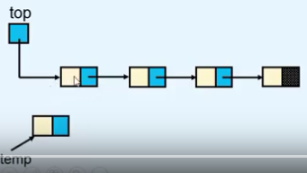
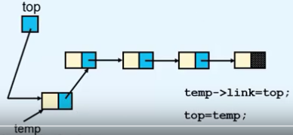
PUSH Operation on Stack
tmp = (struct node *)malloc(sizeof(struct node));
tmp->link=top;
top=tmp;

Slide 30
Push Operation
push()
{
struct node *tmp;
int pushed_item;
tmp = (struct node *)malloc(sizeof(struct node));
printf("Input the new value to be pushed on the stack : ");
scanf("%d",&pushed_item);
tmp->info=pushed_item;
tmp->link=top;
top=tmp;
}/*End of push()*/

Slide 31
Pop Operation
Deleting a node pointed to by start pointer of the list. i.e. at the top of the stack
Stack after Before Pop Operation
Stack after Pop Operation, element at top deleted
Top
XXX
YYY
ZZZ | NULL
Bottom of Stack
Top
YYY
ZZZ | NULL
Bottom of Stack

Slide 32
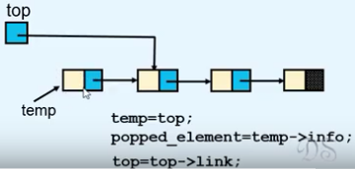
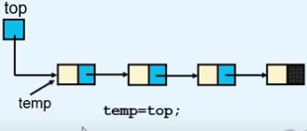
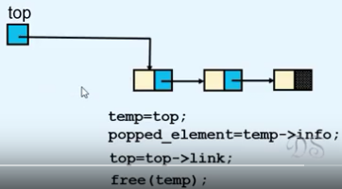
POP Operation on Stack

Slide 33
POP Operation
pop()
{
struct node *tmp;
if(top == NULL)
printf("Stack is empty\n");
else
{
tmp=top;
printf("Popped item is %d\n",tmp->info);
top=top->link;
free(tmp);
}
}/*End of pop()*/

Slide 34
Display Operation
display()
{ struct node *ptr;
ptr=top;
if(top==NULL)
printf("Stack is empty\n");
else
{
printf("Stack elements :\n");
while(ptr!= NULL)
{
printf("%d\n",ptr->info);
ptr = ptr->link;
}/*End of while */
}/*End of else*/
}/*End of display()*/

Slide 35
Application of Stack

Slide 36
Application of Stack –Reversal of a String
Push each character of the string on the stack.
When whole string is pushed on the stack
Pop the characters from the stack to get the reversed string

Slide 37
Application of Stack –Reversal of a String
Try Writing the Code snippet for it……..

Slide 38
Application of Stack –Polish Notation
Polish notation (PN), also known as
  normal Polish notation (NPN)
  Łukasiewicz notation
  Warsaw notation,
  Polish prefix notation or
  simply prefix notation,

Slide 39
Polish Notation-Prefix Notation
Is a mathematical notation in which operators precede their operands,
The description "Polish" refers to the nationality of logician Jan Łukasiewicz who invented Polish notation in 1924.

Slide 40
Reverse Polish Notation-Postfix Notation
Reverse Polish notation (RPN), in which operators follow their operands.
The term Polish notation is sometimes taken (as the opposite of infix notation) to also include reverse Polish notation.0

Slide 41
Expression Representation
An expression is defined as a number of operands or data items combined using several operators.
3 popular methods for representation:
  Infix Notation
  Prefix Notation
  Postfix Notation

Slide 42
Infix Notation
Used in General Mathematics
Operator is written in between the operands
Eg- a+b, x+y*z
Called infix because of the position of the operator in expression.
Evaluation-
Evaluated left to right but operator precedence must be taken into consideration
Not used inside computer, due to additional complexity of handling of precedence

Slide 43
Prefix Notation
Operator is written before the operands
Also called Polish Notation
Eg- +ab, +x*yz

Slide 44
Postfix Notation
Operator is written after the operands
Also called Reverse Polish or Suffix Notation
Eg- ab+, xyz*+

Slide 45
Polish Notation
Prefix and Postfix are free from any precedence
Computers use postfix form

Slide 46
Notation Conversion
Scan the expression from left to right
Operator Precedence-
  Paranthesis evaluated first
  After that evaluation is on the basis of operator precedence
      Logical Not
      Exponential Operator
      Multiplication/division/modulus
      Addition/Subtraction
      Left shift,Right Shift
      Relational
      Logical And
      Logical Or

Slide 47
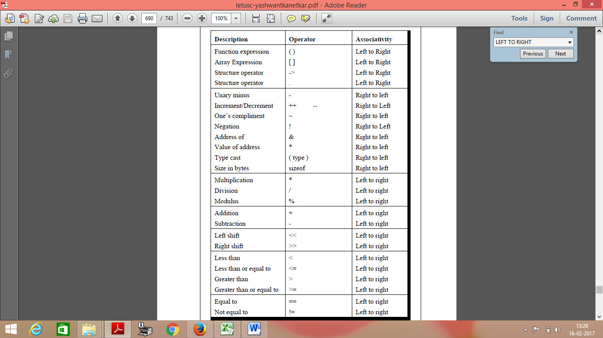
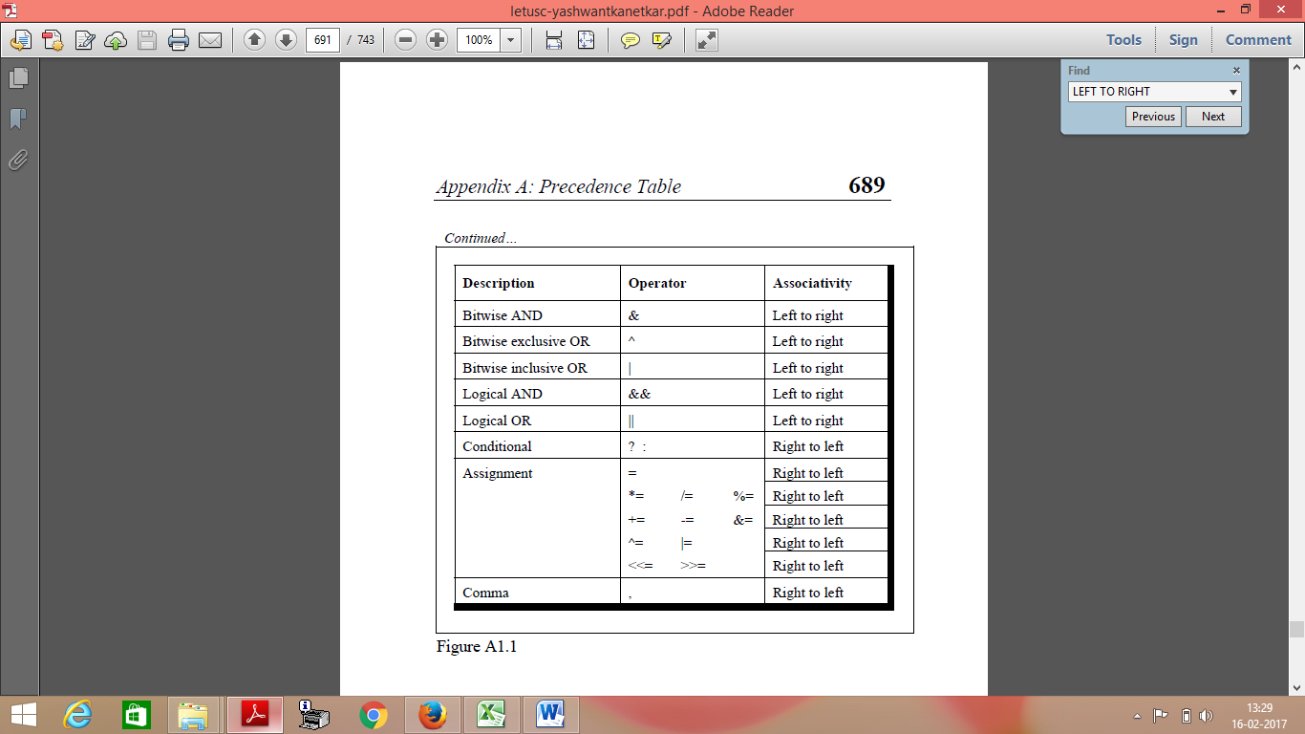
Operator Precedence Table

Slide 48
Manual Conversion -Infix to Postfix
A+ B * C Given infix form
Left to right scan, Brackets first then Operator Precedence
A + B C * Convert the multiplication
A B C * + Convert the addition

Slide 49
Manual Conversion -Infix to Postfix
A+[(B+C)+(D+E)*F]/G

Slide 50
Manual Conversion -Infix to Postfix
A+[(B+C)+(D+E)*F]/G
Left to right scan, Brackets first then Operator Precedence
A+[(BC+)+(D+E)*F]/G
A+[(BC+)+(DE+)*F]/G
A+[(BC+)+(DE+)F*]/G
A+[(BC+)(DE+)F*+]/G
A+[(BC+)(DE+)F*+]G/
A[(BC+)(DE+)F*+]G/+
ABC+DE+F*+G/+

Slide 51
Manual Conversion -Infix to Postfix
Convert the following expressions from Infix to Postfix;
A + B + C + D
(A + B) / (C – D)
(A + B) * C - (D - E) * (F + G)
( (A+B) — C * (D/E ) ) + F
( (A + B) * (C– D) + E ) / (F + G)

Slide 52
Manual Conversion -Infix to Postfix
Convert the following expressions from Infix to Postfix;
A + B + C + D
=AB+ +C +D
=AB+C+ +D
=AB+C+D+

Slide 53
Manual Conversion -Infix to Postfix
Convert the following expressions from Infix to Postfix;
(A + B) / (C – D)
=(AB+) / (C-D)
=(AB+) / (C-D)
=(AB+) / (CD-)
=AB+CD-/

Slide 54
Manual Conversion -Infix to Postfix
Convert the following expressions from Infix to Postfix;
A + B + C + D=A B + C + D +
(A + B) / (C – D) =A B + C D - /

Slide 55
Manual Conversion -Infix to Postfix
Convert the following expressions from Infix to Postfix;
A + B + C + D=A B + C + D +
(A + B) / (C – D) =A B + C D - /
(A + B) * C - (D - E) * (F + G)=AB+C*DE-FG+*-

Slide 56
Manual Conversion -Infix to Postfix
Convert the following expressions from Infix to Postfix;
A + B + C + D=A B + C + D +
(A + B) / (C – D) =A B + C D - /
(A + B) * C - (D - E) * (F + G)=AB+C*DE-FG+*-
( (A+B) — C * (D/E ) ) + F=A B + C D E / * - F +

Slide 57
Manual Conversion -Infix to Postfix
Convert the following expressions from Infix to Postfix;
A + B + C + D=A B + C + D +
(A + B) / (C – D) =A B + C D - /
(A + B) * C - (D - E) * (F + G)=AB+C*DE-FG+*-
( (A+B) — C * (D/E ) ) + F=A B + C D E / * - F +
( (A + B) * (C– D) + E ) / (F + G)=A B + C D - * E + F G + /

Slide 58
Manual Conversion -Infix to Prefix
A/B^C+D

Slide 59
Manual Conversion -Infix to Prefix
A/B^C+D
Left to right scan, Brackets fist then Operator Precedence
A/^BC+D
/A^BC+D
+/A^BCD

Slide 60
Manual Conversion -Infix to Prefix
Convert the following expressions from Infix to Prefix;
(P*Q^R+S)
(A-B/C)*(D*E-F)
(A*B+(C/D))-F
A+B*C-(D/E^F)*G*H
(A+B)*C/D+E^F/G

Slide 61
Manual Conversion -Infix to Prefix
Convert the following expressions from Infix to Prefix;
(P*Q^R+S)=+*P^QRS

Slide 62
Manual Conversion -Infix to Prefix
Convert the following expressions from Infix to Prefix;
(P*Q^R+S)=+*P^QRS
(A-B/C)*(D*E-F)=*(-A/BC)(-*DEF)

Slide 63
Manual Conversion -Infix to Prefix
Convert the following expressions from Infix to Prefix;
(P*Q^R+S)=+*P^QRS
(A-B/C)*(D*E-F)=*(-A/BC)(-*DEF)
(A*B+(C/D))-F=-+*AB/CDF

Slide 64
Manual Conversion -Infix to Prefix
Convert the following expressions from Infix to Prefix;
(P*Q^R+S)=+*P^QRS
(A-B/C)*(D*E-F)=*-A/BC-*DEF)
(A*B+(C/D))-F=-+*AB/CDF
A+B*C-(D/E^F)*G*H
  =A+*BC-(/D^EF)*G*H
  =A+*BC-*/D^EFG*H
  =A+*BC-**/D^EFGH
  =+A*BC-**/D^EFGH
  =-+A*BC**/D ^EFGH

Slide 65
Manual Conversion -Infix to Prefix
Convert the following expressions from Infix to Prefix;
(P*Q^R+S)=+*P^QRS
(A-B/C)*(D*E-F)=*(-A/BC)(-*DEF)
(A*B+(C/D))-F=-+*AB/CDF
A+B*C-(D/E^F)*G*H
  =A+*BC-(/D^EF)*G*H
  =A+*BC-*/D^EFG*H
  =A+*BC-**/D^EFGH
  =+A*BC-**/D^EFGH
  =-+A*BC**/D ^EFGH
(A+B)*C/D+E^F/G
  =+AB*C/D+E^F/G
  =+AB*C/D+^EF/G
  =*+ABC/D+^EF/G
  =/*+ABCD+^EF/G
  =/*+ABCD+/^EFG
  =+/*+ABCD/^EFG

Slide 66
Algorithm for Infix to Postfix using stack
Step 1-Put the opening bracket ‘(‘ on the start of the expression and add the closing bracket ‘)’ at the end of the input expression ‘P’
Step 2-Scan the Expression P from left to right and repeat steps 3 to 6 for each element of P until the stack is empty
Step 3-If an operand is encountered, add it to the output expression ‘Q’
Step 4-If a left bracket is encountered push it onto the stack

Slide 67
Algorithm for Infix to Postfix using stack
Step 5-If an operator is encountered then
5a)Repatedly pop from the stack and add to the output expression Q, each operator which has the same or higher priority compared to the operator just scanned.
5b) then Add the operator just scanned to the stack
Step 6-Ifa right bracket ‘)’ is encountered then repeatedly pop from the stack and add to the output expression Q until a left bracket is encountered.
Pop the left bracket also

Slide 68
Infix to Postfix Conversion using stack
Eg- P=(A+B)*C

Slide 69
Infix to Postfix Conversion using stack
Eg- P=(A+B)*C
P=( (A+B) * C )
Scan | Stack | Expression Q
( | (
( | ((
A | (( | A
+ | ((+ | A
B | ((+ | AB
) | ( | AB+
* | (* | AB+
C | (* | AB+C
) | NULL | AB+C*

Slide 70
Infix to Postfix Conversion using stack
Convert P/(Q-R)*S+T

Slide 71
Infix to Postfix Conversion using stack
Convert P/(Q-R)*S+T=(P/(Q-R)*S+T)
Scan | Stack | Expression Q
( | (
P | ( | P
/ | ( / | P
( | ( / ( | P
Q | ( / ( | PQ
- | ( / (- | PQ
R | ( / (- | PQR
) | ( / Rule 5a) | PQR-
* | ( * | PQR-/
S | ( * | PQR-/S
+ | ( + | PQR-/S*
T | ( + | PQR-/S*T
) | NULL | PQR-/S*T+

Slide 72
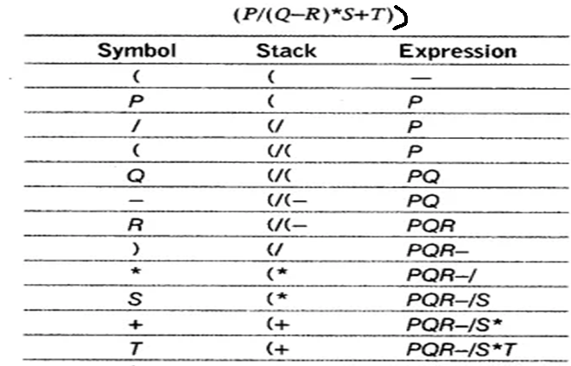
Infix to Postfix Conversion using stack
Convert (P/(Q-R)*S+T)
null
PQR-/S*T+

Slide 73
Infix to Postfix Conversion using stack
Convert P=a && b||c || ! ( e > f )

Slide 74
Notation Conversion
Scan the expression from left to right
Operator Precedence-
  Paranthesis evaluated first
  After that evaluation is on the basis of operator precedence
      Logical Not
      Exponential Operator
      Multiplication/division/modulus
      Addition/Subtraction
      Left shift,Right Shift
      Relational
      Logical And
      Logical Or

Slide 75
Infix to Postfix Conversion using stack
Convert P=(a && b||c || ! ( e > f ) )
Operator Precedence
Logical Not
Exponential Operator
Multiplication/division/modulus
Addition/Subtraction
Left shift,Right Shift
Relational
Logical And &&
Logical Or ||
Scan | Stack | Expression Q
( | (
a | ( | a
&& | (&& | a
b | (&& Rule 5a | ab
|| | (|| | ab&&
c | (|| | ab&&c
|| | (|| Rule 5a | ab&&c||
! | (||! | ab&&c||
( | (||!( | ab&&c||
e | (||!( | ab&&c||e
> | (||!(> | ab&&c||e
f | (||!(> | ab&&c||ef
) | (||! | ab&&c||ef>
) | NULL | ab&&c||ef>!||

Slide 76
Infix to Postfix Conversion using stack
Convert P=A+(B*C-(D/E^F)*G*H )

Slide 77
Infix to Postfix Conversion using stack
Convert P=(A+(B*C-(D/E^F)*G*H ))
Scan | Stack | Expression Q
( | (
A | ( | A
+ | (+ | A
( | (+( | AB
B | (+( | AB
* | (+(* | AB
C | (+(* | ABC
- | (+(- | ABC*
( | (+(-( | ABC*
D | (+(-( | ABC*D
/ | (+(-( / | ABC*D
E | (+(-( / | ABC*DE
^ | (+(-( / ^ | ABC*DE
F | (+(-(/^ | ABC*DEF
) | (+(- | ABC*DEF^/
* | (+(-* | ABC*DEF^/
G | (+(-* | ABC*DEF^/G
* | (+(-* | ABC*DEF^/G*
H | (+(-* | ABC*DEF^/G*H
) | (+ | ABC*DEF^/G*H*-
) | null | ABC*DEF^/G*H*-+

Slide 78
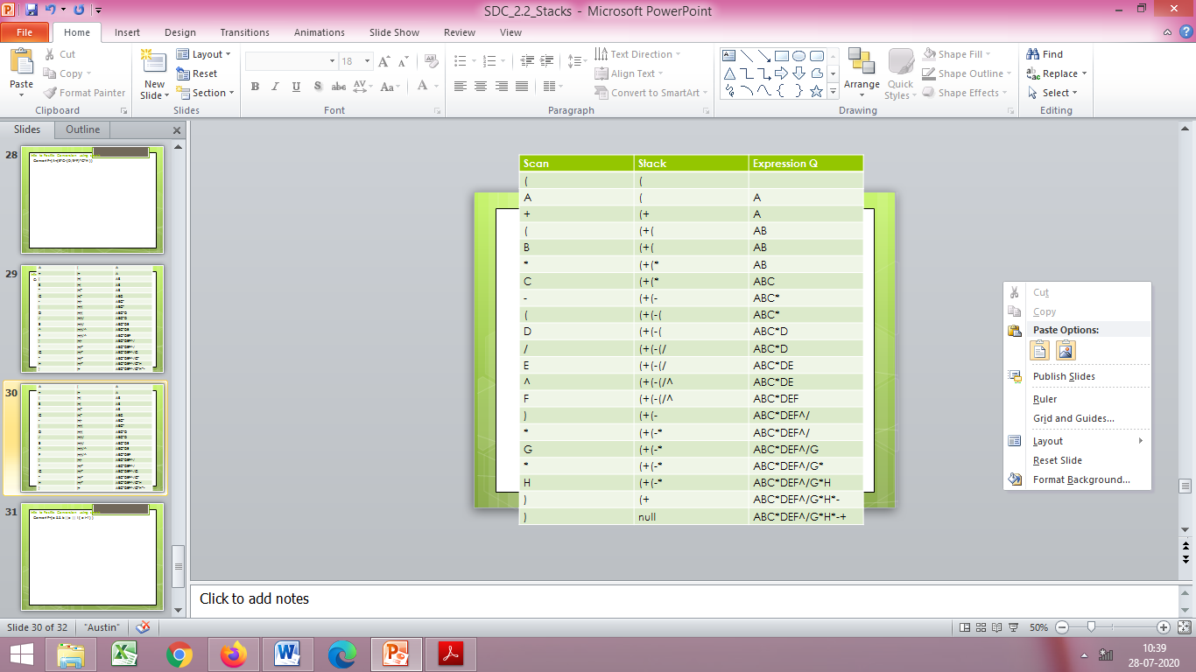
Convert P=(A+(B*C-(D/E^F)*G*H ))

Slide 79
Manual Evaluation of a Prefix notation
+5*32

Slide 80
Manual Evaluation of a Prefix notation
Lets take an eg: +5*32
Find an operator from left to right having 2 operands after it
Multiplication of 3 and 2 is carried out
Expression becomes +56
Now + has two operands so evaluated
Exp=11

Slide 81
Manual Evaluation of a Postfix notation
532*+

Slide 82
Manual Evaluation of a Postfix notation
Lets take an eg: 532*+
Find first operator from left to right having 2 operands before it
perform the operation
Multiplication of 3 and 2 is carried out
Expression becomes 56+
Now + is evaluated
Exp=11

Slide 83
Manual Evaluation
Evaluate the following expression-
P=653+9*+

Slide 84
Algorithm for Evaluation of Postfix using stack
Step 1-Scan the Expression P from left to right and repeat steps 2 and 3 for each element of ‘P’ until the last element
Step 2- If an operand is encountered, push it on the stack
1st operand say ‘a’ is pushed
2nd operand say ‘b’ is pushed
Step 3-If an operator is encountered then
3a) Remove the top two elements of stack and perform
a operator b
(where b is the top element and a is the next element to top element)
3b)Push the result onto the stack
Stack
b
a

Slide 85
Algorithm for Evaluation of Postfix using stack
Evaluate the following expression-
P=653+9*+

Slide 86
Algorithm for Evaluation of Postfix using stack
Stack
Stack
8
6
Stack
72
6
P=653+9*+
P=53+9*+
P=3+9*+
P=+9*+
Evaluate 5+3=8
Push 8
P=9*+
P=*+
Evaluate
8*9=72
Push 72
P=+
Evaluate 6+72=78
Ans=78
Stack
6
Stack
9
8
6
Stack
5
6
Stack
3
5
6

Slide 87
Algorithm for Evaluation of Postfix using stack
Evaluate the following expression-
432*+5-
532*+4-5+
53+82-*
Evaluate 562+*(12)4/-
taking 12 as a single number

Slide 88
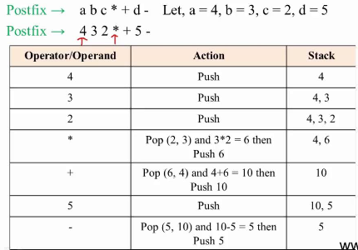
Evaluate 432*+5-

Slide 89
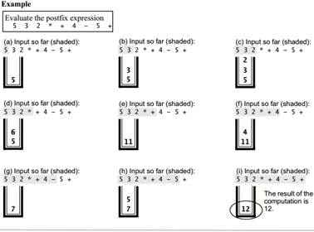

Slide 90
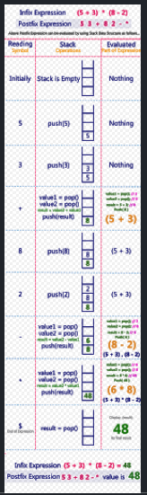
Courtesy:http://btechsmartclass.com/data_structures/postfix-evaluation.html

Slide 91
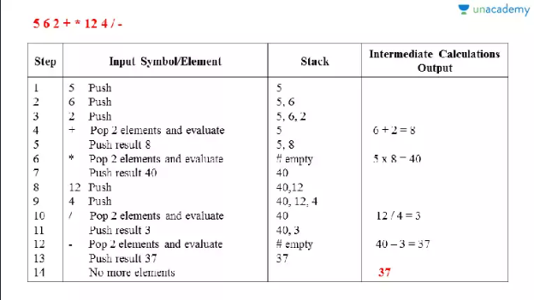
Evaluate 562+*(12)4/- taking 12 as a single number
Courtesy:https://unacademy.com/lesson/evaluation-of-a-postfix-expression-in-tabular-form/8Z5PDFL5

Slide 92
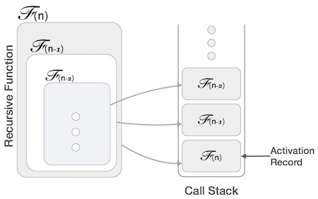
Application of Stack –Recursion

Slide 93
Application of Stack –Recursion
Many programming languages implement recursion by means of stacks.
A function (caller) calls another function (callee) or itself as callee,
  The caller function transfers execution control to the callee.
  This transfer process may also involve some data to be passed from the caller to the callee.

Slide 94
Application of Stack –Recursion
The caller function has
  to suspend its execution temporarily and
  resume later
  when the execution control returns from the callee function.

Slide 95
Application of Stack –Recursion
Here, the caller function needs to start exactly from the point of execution where it puts itself on hold.
  It also needs the exact same data values it was working on.
  So, an activation record (or stack frame) is created for the caller function.
  Activation record keeps the information about
    local variables,
    formal parameters,
    return address and
    all information passed to the callee function.

Slide 96
Application of Stack –Recursion
A recursive function to find the factorial of a positive whole number
int factorial(n)
{
if (n == 1)
{
// base case
return 1;
}
else
{
return n * factorial(n - 1);
// function calls itself
}
}

Slide 97
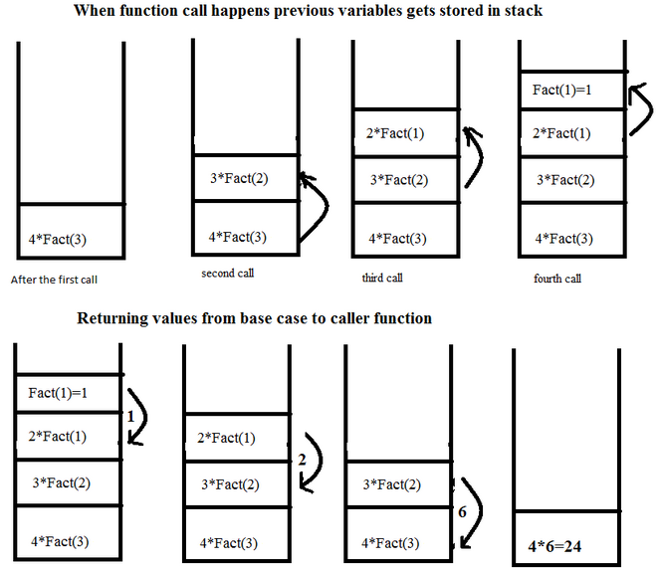
Application of Stack –Recursion

Slide 98
Application of Stack –Recursion
Functions calls are ‘stacked’ one on top of the other,
This is called the call stack (or execution stack)
The call stack operates on a “Last In, First Out” basis. An item is “pushed” onto a stack on function call, and an item is “popped” off the stack when that function returns a value.

Slide 99
Infix to Prefix Conversion using Stack

Slide 100
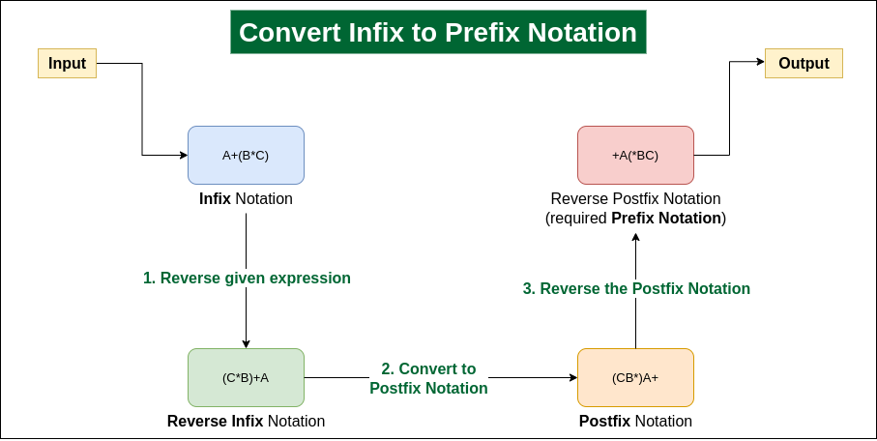

Slide 101
Infix to Prefix Conversion using Stack
Step 1: Reverse the infix expression. Note while reversing each ‘(‘ will become ‘)’ and each ‘)’ becomes ‘(‘.
Step 2: Convert the reversed infix expression to “nearly” postfix expression.
  While converting to postfix expression, instead of using pop operation to pop operators with greater than or equal precedence, here we will only pop the operators from stack that have greater precedence.
Step 3: Reverse the postfix expression.

Slide 102
Infix to Prefix Conversion using stack
Eg- P*Q^R+S

Slide 103
Infix to Prefix Conversion using stack
Eg- P*Q^R+S
Reversing Infix=S+R^Q*P
Postfix Expression=SRQ^P*+
Reverse of Postfix=Prefix Notation=+*P^QRS
Scan | Stack | Expression Q
S |  | S
+ | + | S
R | + | SR
^ | +^ | SR
Q | +^ | SRQ
* | +* | SRQ^
P | +* | SRQ^P
End of Expression | Pop all elements | SRQ^P*+

Slide 104
Manual Conversion -Infix to Prefix
Convert the following expressions from Infix to Prefix;
(P*Q^R+S)=+*P^QRS
(A-B/C)*(D*E-F)=*-A/BC-*DEF
(A*B+(C/D))-F=-+*AB/CDF
A+B*C-(D/E^F)*G*H
  =A+*BC-(/D^EF)*G*H
  =A+*BC-*/D^EFG*H
  =A+*BC-**/D^EFGH
  =+A*BC-**/D^EFGH
  =-+A*BC**/D ^EFGH
(A+B)*C/D+E^F/G
  =+AB*C/D+E^F/G
  =+AB*C/D+^EF/G
  =*+ABC/D+^EF/G
  =/*+ABCD+^EF/G
  =/*+ABCD+/^EFG
  =+/*+ABCD/^EFG

Slide 105
Infix to Prefix Conversion using stack
Eg- (A-B/C)*(D*E-F)

Slide 106
Infix to Prefix Conversion using stack
Eg- (A-B/C)*(D*E-F)
Reversing Infix=(F-E*D)*(C/B-A)
Postfix Expression=FED*-CB/A-*
Reverse of Postfix=Prefix Notation=*-A/BC-*DEF
Scan | Stack | Expression Q
( | (
F | ( | F
- | (- | F
E | (- | FE
* | (-* | FE
D | (-* | FED
) | NULL | FED*-
* | * | FED*-
( | *( | FED*-
C | *( | FED*-C
Scan | Stack | Expression Q
/ | *(/ | FED*-C
B | *(/ | FED*-CB
- | *(- | FED*-CB/
A | *(- | FED*-CB/A
) | * | FED*-CB/A-
End of Expression | Pop all elements | FED*-CB/A-*

Slide 107
Manual Conversion -Infix to Prefix
Convert the following expressions from Infix to Prefix;
(P*Q^R+S)=+*P^QRS
(A-B/C)*(D*E-F)=*-A/BC-*DEF
(A*B+(C/D))-F=-+*AB/CDF
A+B*C-(D/E^F)*G*H
  =A+*BC-(/D^EF)*G*H
  =A+*BC-*/D^EFG*H
  =A+*BC-**/D^EFGH
  =+A*BC-**/D^EFGH
  =-+A*BC**/D ^EFGH
(A+B)*C/D+E^F/G
  =+AB*C/D+E^F/G
  =+AB*C/D+^EF/G
  =*+ABC/D+^EF/G
  =/*+ABCD+^EF/G
  =/*+ABCD+/^EFG
  =+/*+ABCD/^EFG

Slide 108
Infix to Prefix Conversion using stack
Eg- (A*B+(C/D))-F

Slide 109
Infix to Prefix Conversion using stack
Eg- (A*B+(C/D))-F
Reversing Infix=F-((D/C)+B*A)
Postfix Expression= FDC/BA*+-
Reverse of Postfix=Prefix Notation=-+*AB/CDF
Scan | Stack | Expression Q
F |  | F
- | - | F
( | -( | F
( | -(( | F
D | -(( | FD
/ | -((/ | FD
C | -((/ | FDC
) | -( | FDC/
+ | -(+ | FDC/
B | -(+ | FDC/B
Scan | Stack | Expression Q
* | -(+* | FDC/B
A | -(+* | FDC/BA
) | - | FDC/BA*+
End of Expression | Pop all elements | FDC/BA*+-

Slide 110
Manual Conversion -Infix to Prefix
Convert the following expressions from Infix to Prefix;
(P*Q^R+S)=+*P^QRS
(A-B/C)*(D*E-F)=*-A/BC-*DEF
(A*B+(C/D))-F=-+*AB/CDF
A+B*C-(D/E^F)*G*H
  =A+*BC-(/D^EF)*G*H
  =A+*BC-*/D^EFG*H
  =A+*BC-**/D^EFGH
  =+A*BC-**/D^EFGH
  =-+A*BC**/D ^EFGH
(A+B)*C/D+E^F/G
  =+AB*C/D+E^F/G
  =+AB*C/D+^EF/G
  =*+ABC/D+^EF/G
  =/*+ABCD+^EF/G
  =/*+ABCD+/^EFG
  =+/*+ABCD/^EFG

Slide 111
extra

Slide 112
Application of Stack –Recursion
Time Complexity
In iterations,
  we take number of iterations to count the time complexity.
In recursion,
  assuming everything is constant,
  count the number of times a recursive call is being made.
Space Complexity
Space complexity is counted as
  what amount of extra space is required for a module to execute.
In iterations,
  the compiler hardly requires any extra space.
  The compiler keeps updating the values of variables used in the iterations.

Slide 113
Application of Stack –Recursion
Time Complexity
  A call made to a function is Ο(1),
    hence the (n) number of times a recursive call is made
    makes the recursive function Ο(n).
Space Complexity
In recursion,
  the system needs to store activation record each time a recursive call is made.
  Thus, space complexity of recursive function
    may go higher than that of a function with iteration.

